Slide 1
ConnectBud
C++
Class 1
By: Rahul Joshi

Slide 2
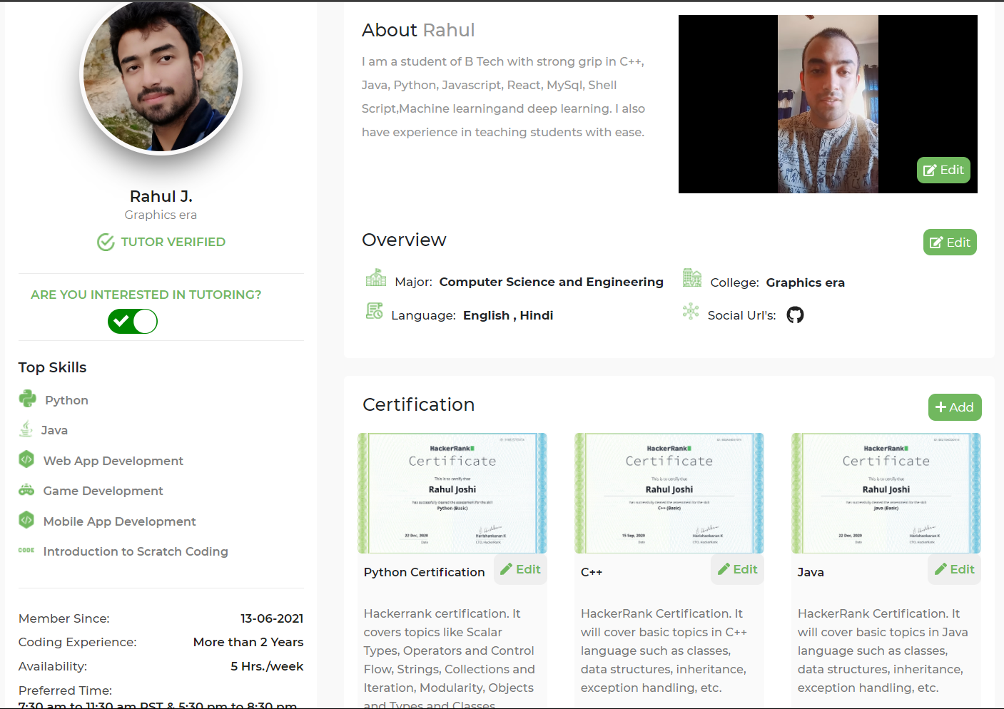

Slide 3
Course Overview
Class 1: • Introduction of C++
• Environment setup

Slide 4
Introduction
C++ is a programming language.
Eg. Let a=10
A=a+1
A++
To create computer programms.

Slide 5
First program
#include <iostream>
using namespace std;
int main() {
cout << "Affan";
return 0;
}

Slide 6
Commands
Pwd : path
Python –version : Check the version
cd : Change Directory
cd .. : return to parent folder
cd arav : go inside arav folder.
Mkdir : make directory(creating folders).
ls : list

Slide 7
End
For any queries: Contact:
Rahul Joshi rj26280218@gmail.com

